Slide 1






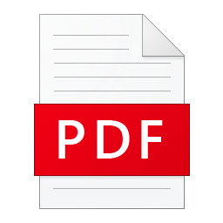

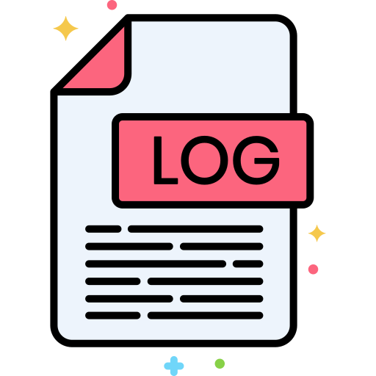


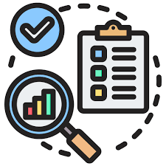
Validation Reporting With Pipeline Logging, Monitoring and Alerting
Once validation is complete, automatically shares the validated report with the respective vendor
GAC Team
Vendor responses
Automated Monthly company report on every 28th
Automated Custom Alerts for ‘Logic failure’ OR ’alert scenarios’ with severity level
LLM model for data prep
Model to analyze and validate
Automated Vendor reporting


Automated Alerts with logs for
pipeline crashes ( network, infra or platform issues )
Contracts data
Logging of Success, Failure, Output and Error of each step into a central log table
Azure Stack
Pipeline orchestrated by data-factory
Logics written in databricks
PDF, Visual, Excel reports
Email/Teams notifications with attachments
End to End Pipeline Monitoring
3 Point validation
Invoices

Slide 2
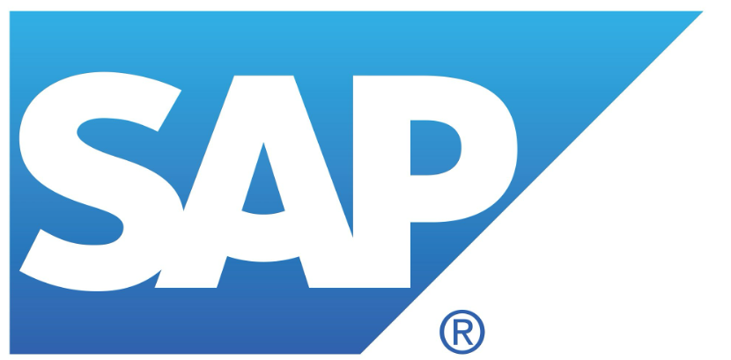
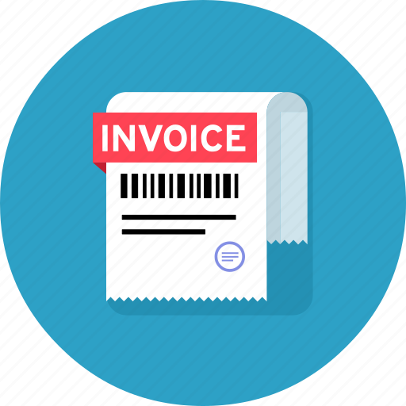
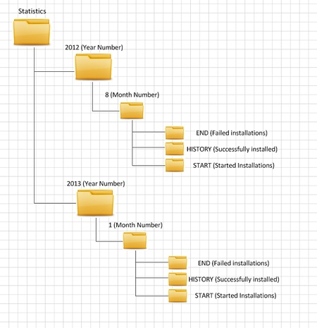

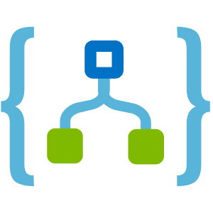
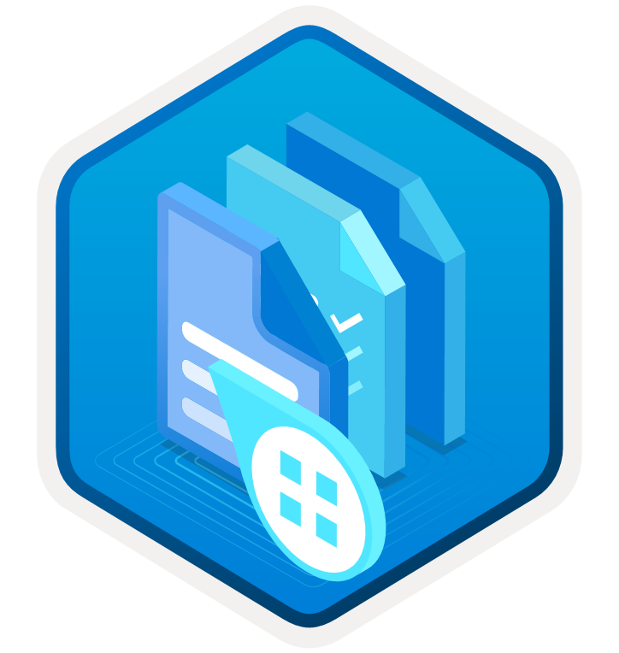
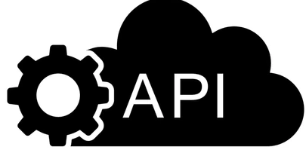


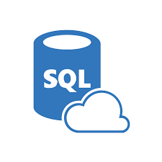
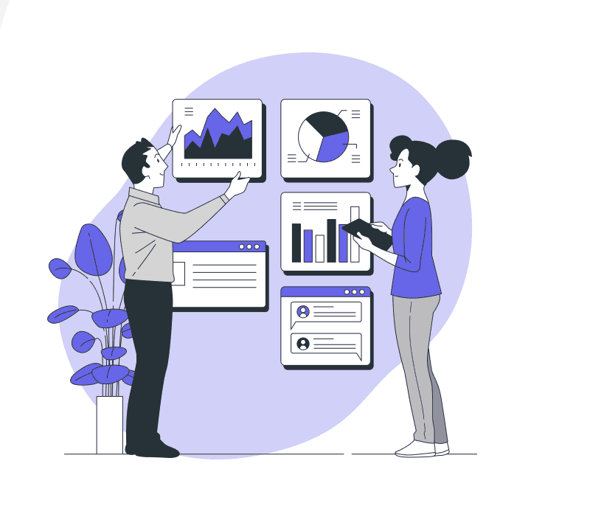

Improving Financial Accuracy with AI-Based Contract Analysis
Minimizing the risk of financial discrepancies, analyzing the data to detect any mismatches in pricing between the contract, PO, and invoices,
Contract file
Data Collection
Gathering and Combining data from different Sources using SAP API, Azure document intelligence and ADI prebuilt invoice model
Logic App for Automation
Extract key information such as customer name, billing address, due date, pricing and amount due into a structured JSON data format
Document Intelligence
SAP API or SAP Connector
Azure Invoice Model
Alerts and Audit
Processing and Result
The generated data will be processed by the LLM, stored in the required format, and discrepancies will be identified through comparison using multilayer codes.
LLM Prompt tunned Layer to understand the information extracted by document intelligence/Invoice model and format it into required format
Discrepancies
Multi Layer Comparison Logics

